Slide 1

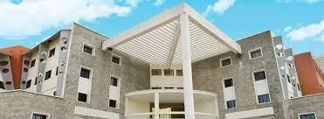
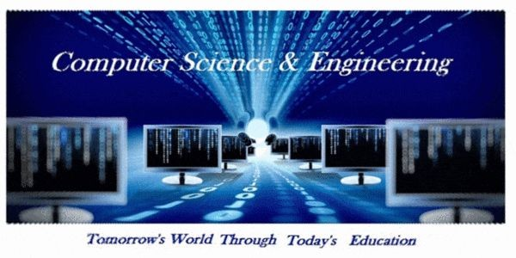
Department of CSE
PCL- Review
Crop Disease Prediction Using Deep Learning
Roshan Kumar (19BTRCS061)
Vikash Kumar (19BTRCS105)
Guide: Prof P T Shiv Shankar

Slide 2
Department of CSE
Abstract with keywords
PCL- Review
With increase in population the need for food is on rise, in such circumstances, plant diseases prove to be a major threat to agricultural produce and result in disastrous consequences for farmers. Early detection of plant disease can help in ensuring food security and controlling financial losses. In this project, we are focusing on the potato disease classification which are affecting the farmers adversely. If a farmer can detect these disease at early time and apply appropriate treatment then it can save lot of waste and prevent their economic losses too. We are proposing the mobile application which will detect the disease of the potato with better accuracy and at backend we are using deep learning.
Keywords: - Potato disease, image processing, segmentation, data augmentation, classification, FastAPI, Tensorflow lite, React Native, React JS, GCP, Mobile Application, Tf serving.

Slide 3
Department of CSE
Introduction
PCL- Review
Rapid population growth over recent decades has resulted in an increased demand for agricultural goods, which in turn has lead to a large expansion of cultivation. To meet rising population demands for food, bio-fuels, and animal products, crop yield production must double its output by 2050. In order to achieve this goal, key crop yields must improve by 2.4% each year, but they are now only increasing by roughly 1.3% per year.
There are two common disease of potato known as early blight (caused by fungus) and late blight (caused by specific microorganism).
We have end to end project which is very helpful in agriculture domain. Our aim is to prevent the wastage of crop as it needs lot of effort to grow a crop and wastage never worth it.
It will also help the farmers to prevent from financial losses.

Slide 4
Department of CSE
Proposed System
PCL- Review
We will build a mobile application which they can give it to a farmer. And farmer all they need to do is go to their farm and just take a picture of a plant and the mobile application will tell whether the potato plant is healthy or it has one of these disease.

Slide 5
Department of CSE
Implementation
PCL- Review
We will collect the different healthy and unhealthy pictures of potato disease from the online platform and classify the dataset. After that we will use train the dataset with CNN(Convolutional Neural Network) model to analyse the trends in the dataset.
We will deploy the model in mobile application with the help of React JS and GCP(Google Cloud Platform), to provide efficiency to the farmers.

Slide 6
Department of CSE
Results and Discussion
PCL- Review
Our proposed solution will add values to the society and help the farmers to know the accurate disease of the potato crop and hence can cure the disease more accurately.
It prevents from the financial losses of farmers.
It also prevent wastage of crop. Our application is made with user friendly interface and predict the disease more accurately.

Slide 7
Department of CSE
Conclusion and Future work
PCL- Review
The model will make the sustainable life cycle. We will keep the model updated to get more precise result. We will add chatbot if required to help the farmers to know about the disease and the ways to prevent the disease.

Slide 8
Department of CSE
PCL- Review
Thank you :-)
Any Questions??

